Slide 1

An AI-Driven 4D Digital Cell for Multiscale Genome-to-Phenotype Simulation, Cellular State Prediction and In-Silico Genetic Perturbation
R. Sanjay:192422094
M. Balaji:192422050
Sk Khadhir Ahamad:192520045
I.Mohamed Yaqub:1920260024
Guided by:A.Swathi

Slide 2


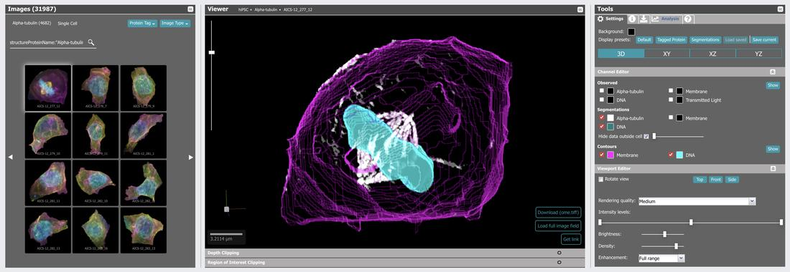
Aim of the Project
To develop an AI-driven 4D digital cell model.
To connect genetic information with cellular functions.
To simulate cellular changes over time.
To predict cellular states using AI.
To study the effects of genetic changes through computer-based simulations.

Slide 3
Introduction
A cell is the basic unit of life. Every cell contains genes that control its activities, such as growth, energy production, and protein formation. Changes in genes can affect how a cell functions and may lead to diseases.
Artificial Intelligence (AI) and Machine Learning (ML) can help scientists understand how genes influence cell behavior.
A 4D Digital Cell is a computer-based model that represents how a cell behaves and changes over time. Here, the four dimensions refer to three-dimensional space (3D) and time (4D).
This project aims to develop a simple AI-based computational model that connects genes with cellular activities and predicts possible changes in a cell when a gene is modified.
The model can help researchers study cellular behavior without performing every experiment in a laboratory.

Slide 4
Scope of the Project
Analyze gene-expression data to understand cellular activities.
Predict cellular states using Machine Learning techniques.
Study relationships between genetic information and observable cellular characteristics.
Simulate possible effects of changes in selected gene-expression levels.
Support future research in disease studies and drug discovery through computational predictions.

Slide 5
Objectives
The main objectives are:
Collect biological data: Obtain gene-expression and cellular data from public biological databases.
Analyze gene activity: Use simple computational tools to understand gene-expression patterns.
Predict cellular states: Apply Machine Learning to predict possible cellular conditions based on biological data.
Simulate genetic perturbations: Study how increasing, decreasing, or modifying the activity of a selected gene may affect cellular behavior.
Connect genes to phenotypes: Understand how changes in gene activity may influence observable cellular characteristics.
Visualize results: Present the predicted changes through graphs, tables, and simple visualizations.

Slide 6
Module 1 — Biological Data Collection and Preparation
Collect gene-expression data from the NCBI Gene Expression Omnibus (GEO) database.
Select a suitable cell type or biological condition.
Download and organize the gene-expression dataset using Python.
Handle missing values and clean the data using Pandas.
Prepare the dataset for AI-based analysis.

Slide 7
MODULE 2: AI-Based Gene Expression Analysis and Cellular State Prediction
Load the prepared dataset into Google Colab.
Analyze gene-expression levels using Python and Pandas.
Visualize gene-expression patterns using graphs and heatmaps.
Divide the dataset into training and testing sets.
Train a Random Forest Classifier to predict cellular states.
Evaluate the model using accuracy and other suitable performance measures.

Slide 8
MODULE 3: Genetic Perturbation, Simulation and 4D Visualization
Select a gene from the prepared dataset.
Record its original gene-expression value.
Simulate an increase or decrease in the selected gene's expression.
Compare cellular state predictions before and after the simulated change.
Visualize the results using graphs and charts.
Use time-based representations where suitable temporal data or a dynamic model is available.
Analyze the possible effects of genetic changes on cellular behavior.

Slide 9
Module 4 — Genetic Perturbation and 4D Visualization
Select a gene from the prepared dataset.
Record its original gene-expression value.
Simulate an increase or decrease in its expression level.
Compare the model's predictions before and after the simulated change.
Visualize the results using graphs and, where suitable temporal data or a dynamic model is available, time-based representations.

Slide 10
Methodology
Data Collection: Collect gene-expression data from the NCBI GEO database.
Data Preparation: Clean and organize the data using Python.
Gene Expression Analysis: Study gene activity and identify patterns.
AI Model Training: Train a Random Forest model using gene-expression data.
Cellular State Prediction: Predict cellular states using the trained model.
Genetic Perturbation: Simulate an increase or decrease in a selected gene's expression.
Result Comparison: Compare the original and simulated cellular state predictions.
Visualization: Present the results using graphs and charts.
Model Evaluation: Check the model's performance using suitable evaluation measures.
Conclusion: Summarize the findings and explain the limitations of the predictions.

Slide 11
Possible Results and Outcomes
A clean gene-expression dataset will be obtained from the NCBI GEO database.
Gene-expression patterns will be identified using graphs and charts.
A Random Forest model will predict cellular states from gene-expression data.
Model accuracy and performance will be evaluated using suitable metrics.
Simulated gene-expression changes will be compared to study differences in model predictions.
Graphs and visualizations will help explain possible changes in cellular behavior.

Slide 12
Conclusion
An AI-driven 4D digital cell is a proposed approach to computationally represent cellular behavior.
It aims to connect genetic information with molecular activities and cellular characteristics.
AI can help predict cellular states and investigate the possible effects of genetic changes.
Combining multiple biological data types may improve the understanding of cellular processes.
Computational predictions must be compared with experimental results before biological conclusions are confirmed.

Slide 13
Literature Review
Digital Cell Modeling: Previous research has explored computer models to understand cellular structures and biological processes.
Artificial Intelligence in Biology: AI and machine learning help analyze complex biological data and predict cellular behavior.
Genome-to-Phenotype Research: Studies investigate how genetic information influences proteins, cellular functions, and observable characteristics.
Single-Cell Analysis: Single-cell RNA sequencing helps researchers understand differences between individual cells.
Genetic Perturbation: Computational methods help predict how changes in gene activity may affect cellular functions.
Research Gap: Integrating genetic, molecular, and cellular information into a reliable, time-dependent digital cell model remains a major challenge.

